Slide 1
Relief Mapping
Advanced Graphics Programming

Slide 2
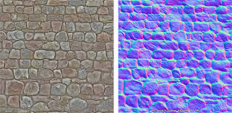
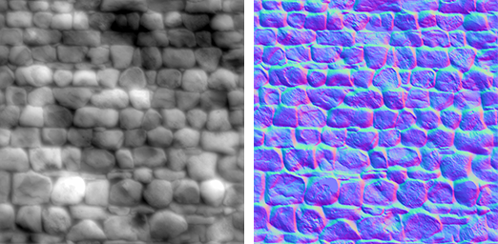
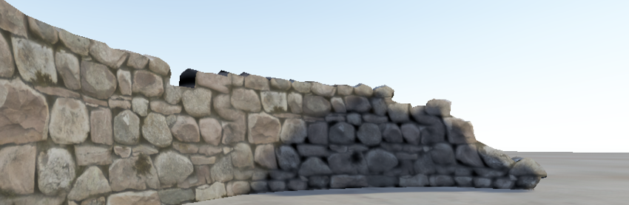
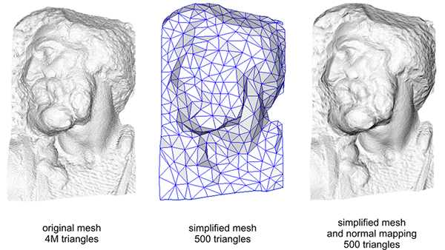
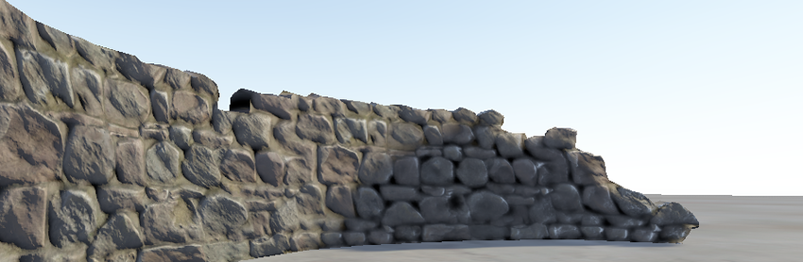
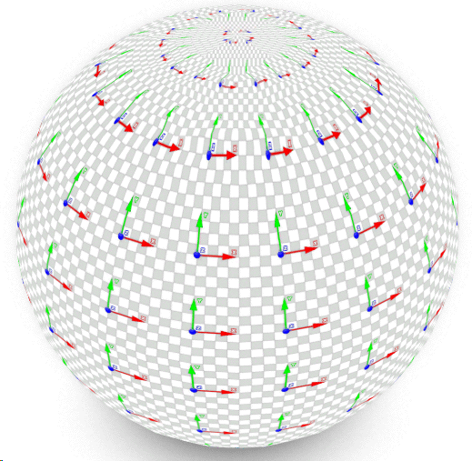
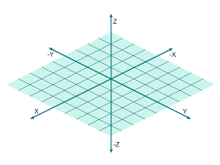
Previously, in normal mapping...
With bump / normal mapping we could add illumination details onto a surface…
More detail with less geometry
Use of bump / normal maps
Use of the tangent space matrix (tangent space -> local space)

Slide 3
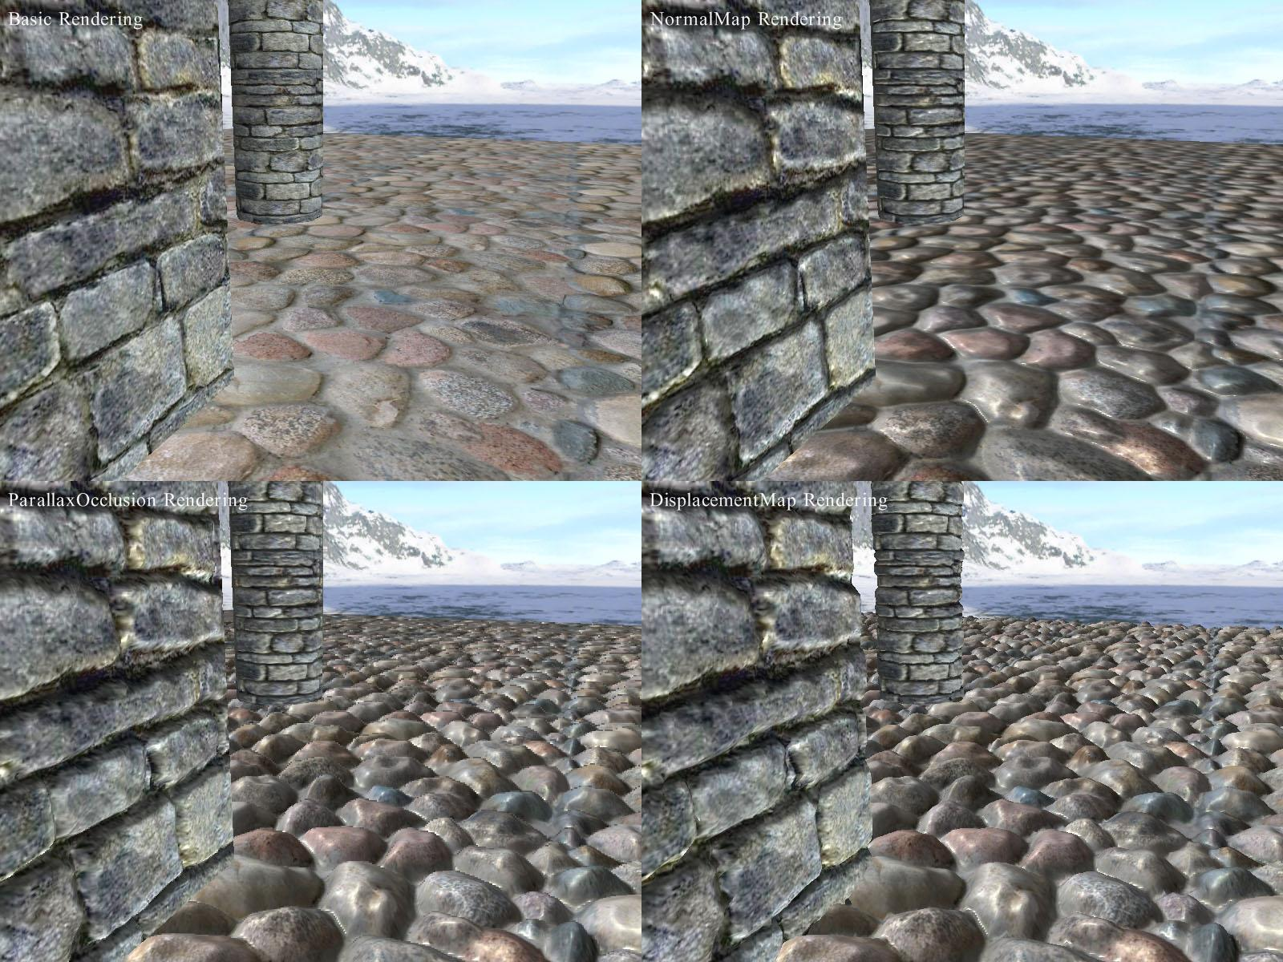
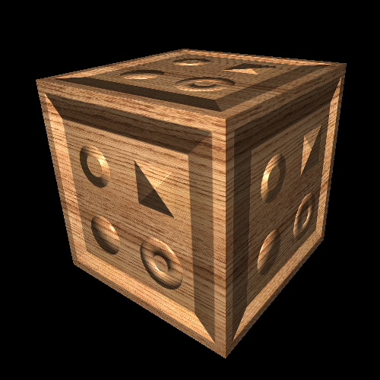
Shortcomings of normal mapping
Even boosting illumination details, it has a couple of shortcomings…
The image is not view-dependent
Flat polygons don’t look so bumpy when observed from glancing angles

Slide 4
Relief mapping to the rescue
Relief mapping is another technique that can achieve even better results.
Color mapping Normal mapping Relief mapping

Slide 5
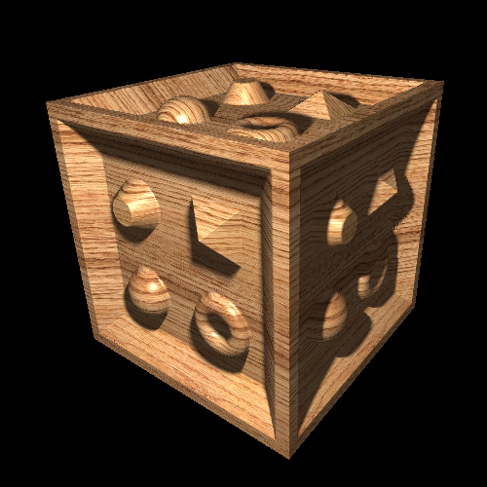
Relief mapping to the rescue
Relief mapping is another technique that can achieve even better results.
Normal mapping Relief mapping

Slide 6
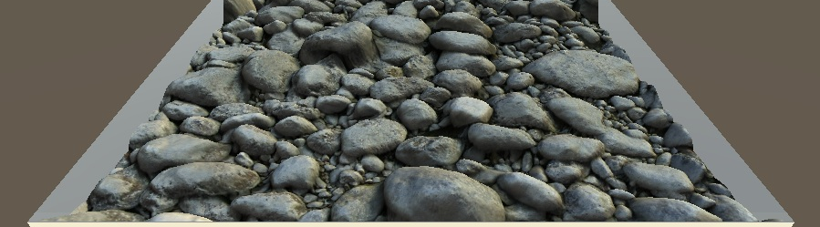
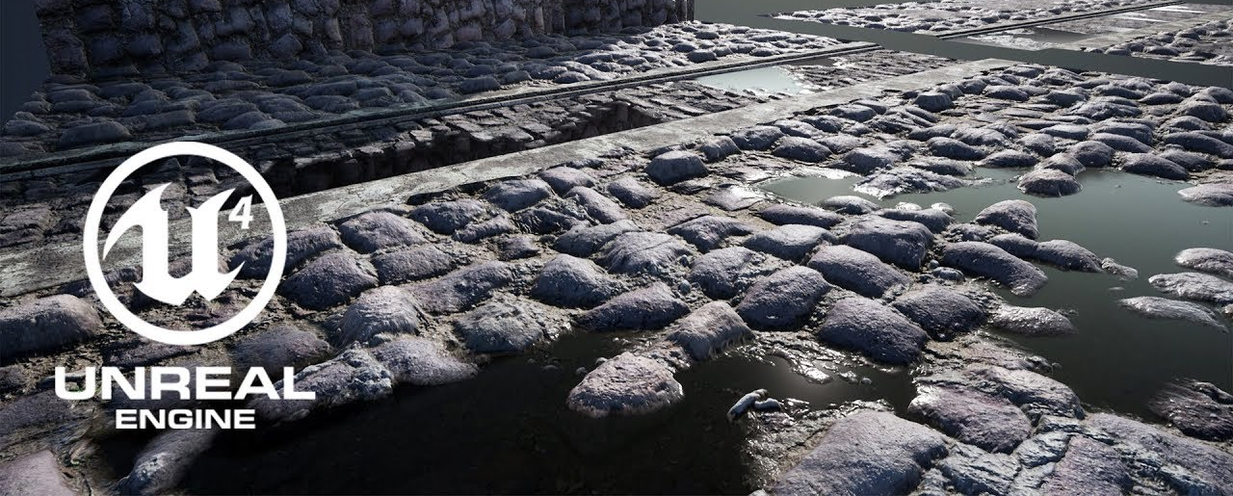
Other names
Techniques with different names, yet they do essentially the same job:
Relief mapping
Steep parallax mapping
Parallax occlusion mapping (Unreal Engine 4)
See this DEMO
POM in Shader Forge
POM in Unreal Engine

Slide 7
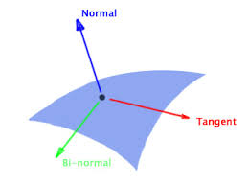
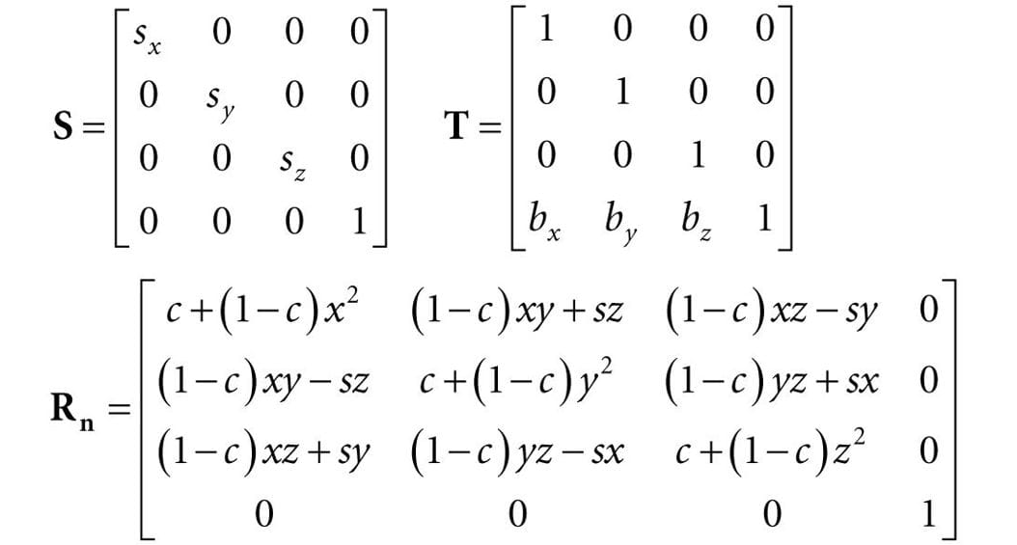
What does it need?
Relief mapping is another technique that can achieve even better results.
The geometry that we will render can be the same
A flat polygon, a model…
Per-vertex attributes: Tangent space matrix (TBN)
The input is almost the same as in normal mapping
Color maps
Bump map
Normal map
Other transformation matrices...
The technique runs completely in the shader, like normal mapping
The algorithm is different
Several texture lookups
both

Slide 8
Idea
Having the depth map of the surface, perform a search in texture space to find the texture coordinates where the view ray hit the surface (the surface as described by the depth map).
It’s basically a small-scale ray tracing algorithm.

Slide 9
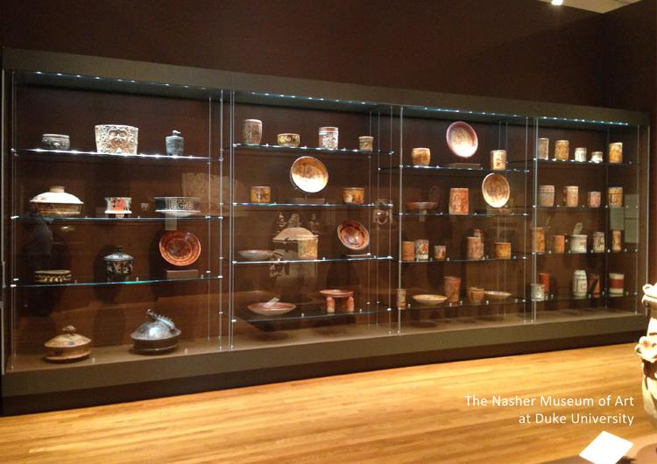
Idea
Imagine a showcase like this…
We can see through the glass from different points of view.
Neither a single color texture nor a normal map can catch that.
A depth map, can help… objects have depth.

Slide 10
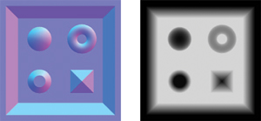
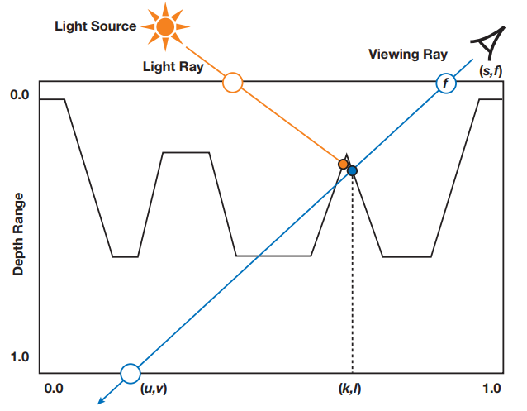
Idea
start

Slide 11
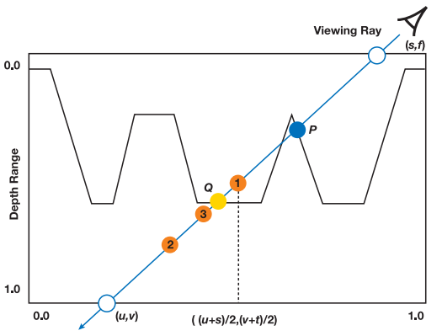
Approach 1: Binary search
start
hit
1
3
2

Slide 12
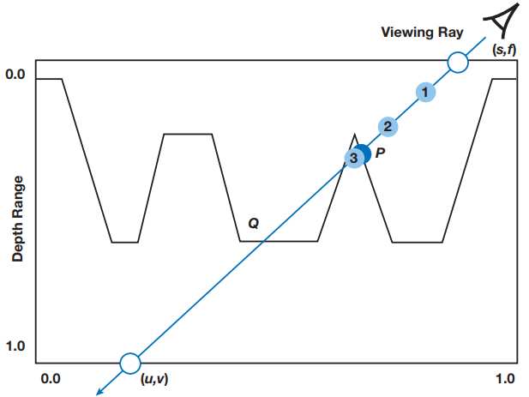
Approach 2: linear search
start
hit

Slide 13
Approach 2: linear search
// Parallax occlusion mapping aka. relief mapping
vec2 reliefMapping(vec2 texCoords)
{
int numSteps = 15;
// Compute the view ray in texture space
rayTexspace = TBNInverse * worldViewMatrixInverse * rayEyespace;
// Increment
vec3 rayIncrementTexspace;
rayIncrementTexspace.xy = bumpiness * rayTexspace.xy / abs(rayTexspace.z * texSize);
rayIncrementTexspace.z = 1.0/numSteps;
// Sampling state
vec3 samplePositionTexspace = vec3(texCoords, 0.0);
float sampledDepth = 1.0 - texture(bumpTexture, samplePositionTexspace.xy).r;
// Linear search
for (int i = 0; i < numSteps && samplePositionTexspace.z < sampledDepth; ++i)
{
samplePositionTexspace += rayIncrementTexspace;
sampledDepth = 1.0 - texture(bumpTexture, samplePositionTexspace.xy).r;
}
return samplePositionTexspace.xy;
}
start
hit

Slide 14
Approach 3: linear + binary search
Steps
Perform linear search until finding a hit sample.
Perform N binary search iterations from the hit sample
At each iteration
Reduce the sampling step to half its length
If the current sample is deeper than the depth map, go backwards
Else, go forwards

Slide 15
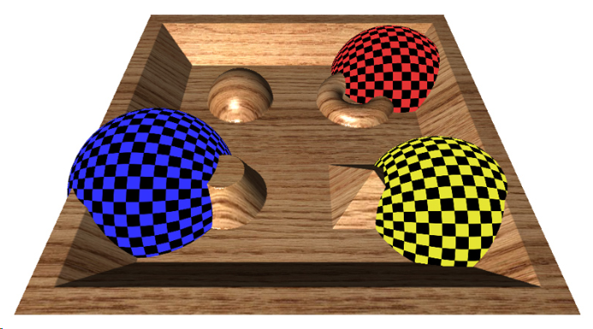
Interpenetration with other geometry
Need to modify gl_FragDepth
The search across the ray in tangent space will return the “correct” texture coordinates.
Besides this, the “correct” depth could be computed and set into the output built-in variable gl_FragDepth.
Disables early z-test.
More inefficient
Allows accurate object inter penetration.

Slide 16
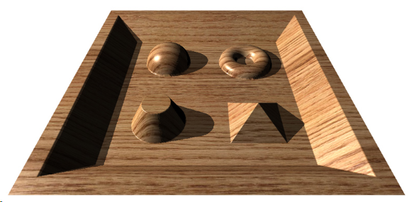
Self shadows
In forward shading:
Extra ray tracing to find the self-occluding geometry.
In deferred shading:
For free if we modify fragments’ depth with gl_FragDepth.

Slide 17
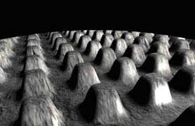
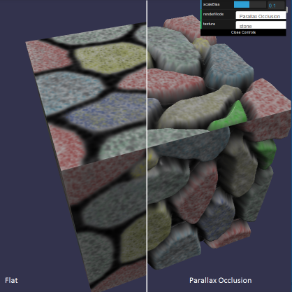
Shortcomings
Relief mapping can provide outstanding results, but it is not a set-and-forget technique:
May cause texels to be visible which are from outside the texture mapping
The more extreme the viewing angle, the more noticeable this artifact
Use the whole extent of a texture and use it with tiling (GL_REPEAT)
More materials
Content creators: handle boundaries
Occluding objects
Avoid tiling
Whole extent of the texture
Thick border used as boundary
http://online.ts2009.com/mediaWiki/index.php/Parallax_Occlusion_Map

Slide 18
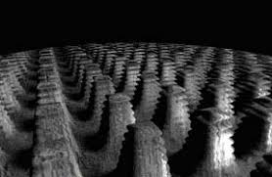
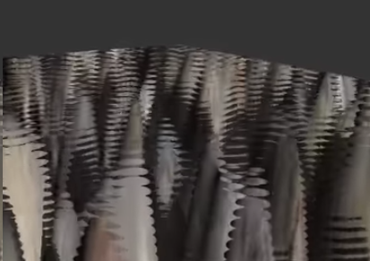
Shortcomings
Relief mapping can provide outstanding results, but it is not a set-and-forget technique:
May show layered discontinuities, also when viewing the surface from glancing angles
Factors incurring this artifact
Extreme viewing angles
Insufficient sampling
Solutions
Increase the sampling density
More expensive
Cone step relief mapping
Approaches rapidly to surface boundaries
Extra storage for the cone parameters

Slide 19
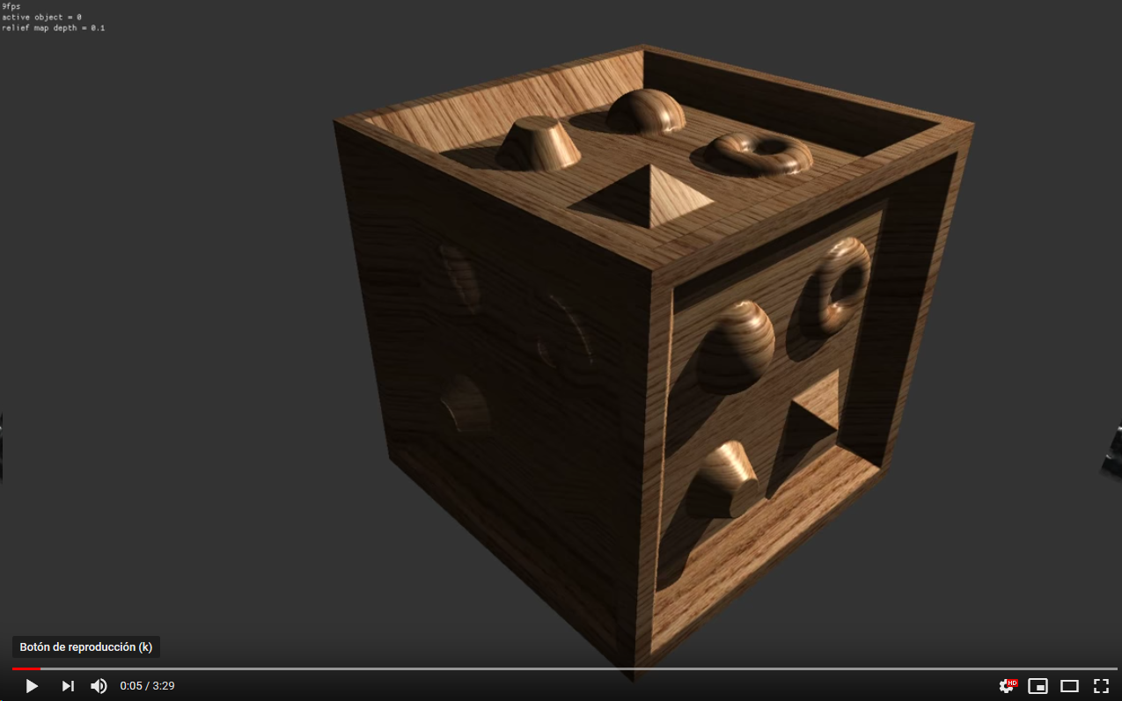
Shortcomings

Slide 20
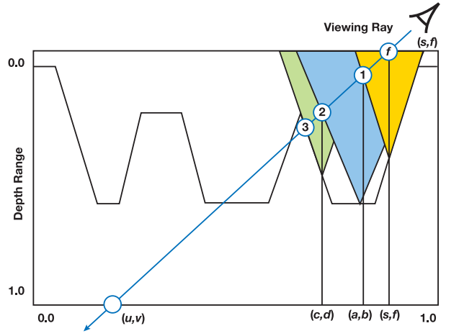
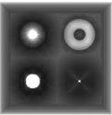
Cone-step relief mapping

Slide 21
Learning resources
A couple of resources:
Original paper by Policarpo et al.
http://www.inf.ufrgs.br/~comba/papers/2005/rtrm-i3d05.pdf
Official relief mapping papers
http://www.inf.ufrgs.br/~oliveira/RTM.html
Parallax / steep parallax / parallax occlusion mapping tutorial
https://learnopengl.com/Advanced-Lighting/Parallax-Mapping
Parallax occlusion mapping definition
http://online.ts2009.com/mediaWiki/index.php/Parallax_Occlusion_Map
Relaxed cone-step relief mapping
http://developer.download.nvidia.com/books/gpu_gems_3/samples/gems3_ch18.pdf
Detailed description of the algorithm here
Detailed description of the cone-stepping extension here

Slide 22
Questions?

